Slide 1
How we see: A visual representation (Data Visualization Optimization via Computational Modeling of Perception)
AUTHOR: Reshu Gupta
Date : mar 2024

Slide 2
Agenda
01
Introduction
02
About Research paper
03
Understanding the Visual System
Information Visualization
Perception
human information processing
Neural net and Optimization
Audience welcome
My Introduction
From Retina To Brain
06
Neural Processing of Visual Information
04
Journey Through the Eye
05

Slide 3
Introduction:
Understanding the Visual System
Journey Through the Eye
From Retina To Brain
Neural Processing of Visual Information
Specialized Function of V1
Impact of Perception

Slide 4

About Paper
“Data Visualization is more of an art than a science”.
Title: Data Visualization Optimization via Computational Modeling of Perception
Author: Daniel Pineo and Colin Ware
Published: IEEE TRANSACTIONS ON VISUALIZATION AND COMPUTER GRAPHICS, VOL. 18, NO. 2, FEBRUARY 2012

Slide 5
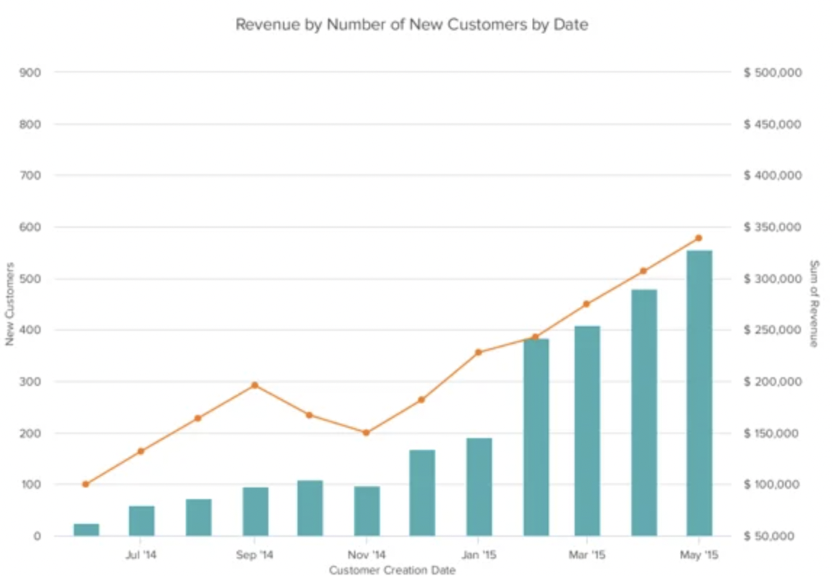
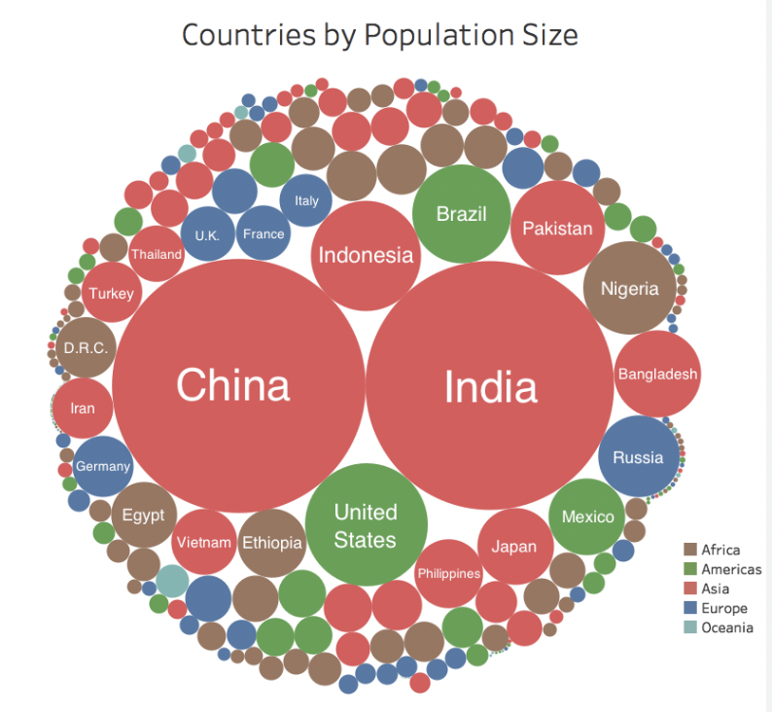
Data visualization
“Data visualization is a powerful tool to convey complex information in a clear and engaging manner.”
Notes:
DV converts textual information into images, shapes, graphs.

Slide 6

Visual Impact on human brain
Visual Dominance
Rapid Processing
Intuitive Understanding
Pattern Recognition
Memory Retention
Emotional Impact
Storytelling

Slide 7
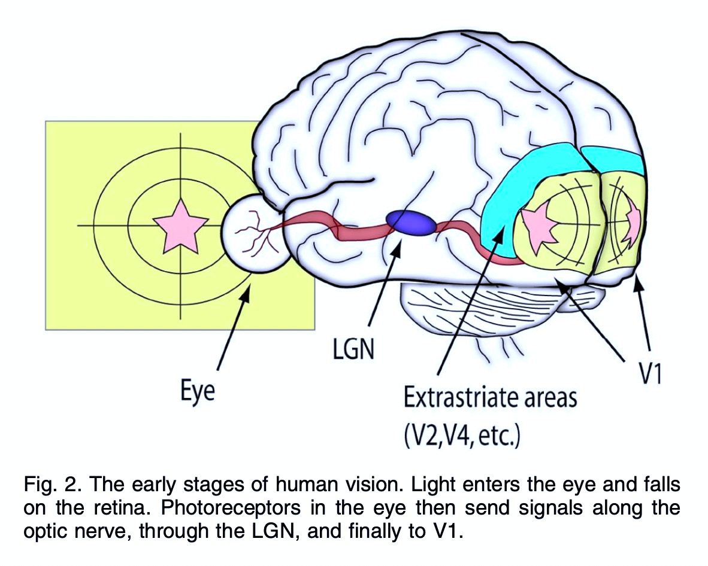
The visual system:
The Visual System is a complex network of organs and processes that allows us to see and interpret the world around us.

Slide 8
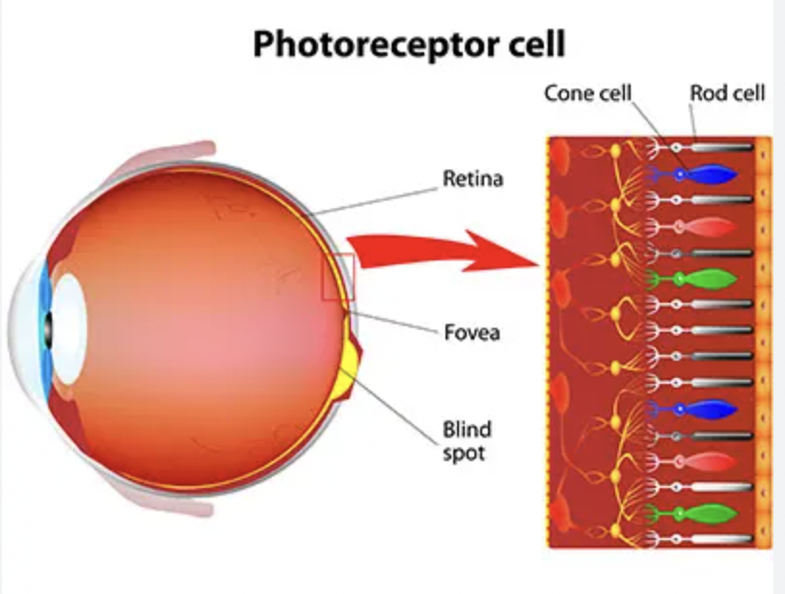
Photoreceptors:
The retina is a complex layer of tissue that contains specialized cells called photoreceptors.
There are two types of photoreceptor cells: cones and rods. Cones are responsible for color vision and detail, while rods are more sensitive to low-light conditions.
The photoreceptor cells receive the light that has been focused onto the retina and convert it into electrical signals.
These signals are then transmitted to the optic nerve, which carries them to the brain for processing.

Slide 9
function of V1:
One of the important of these sub-pathways is the primary visual cortex, also known as V1. V1 is located in the occipital lobe of the brain, which is at the back of the brain, just above the neck. V1 is the first major processing center of the visual information, and it is responsible for the initial analysis of visual stimuli.
V1 processes the basic features of visual information, such as edges, orientation, and motion. It does this by using a variety of different neural mechanisms, including contrast detection, orientation detection, and motion detection. Contrast detection is the process of detecting the difference between light and dark areas of an image, while orientation detection is the process of detecting the direction of lines in an image. Motion detection is the process of detecting movement in an image.

Slide 10
Optimization techniques:
Streaklet Primitives
Pixel Primitives
Hill Climbing Algorithm
Jobard and Lofer Algorithm

Slide 11
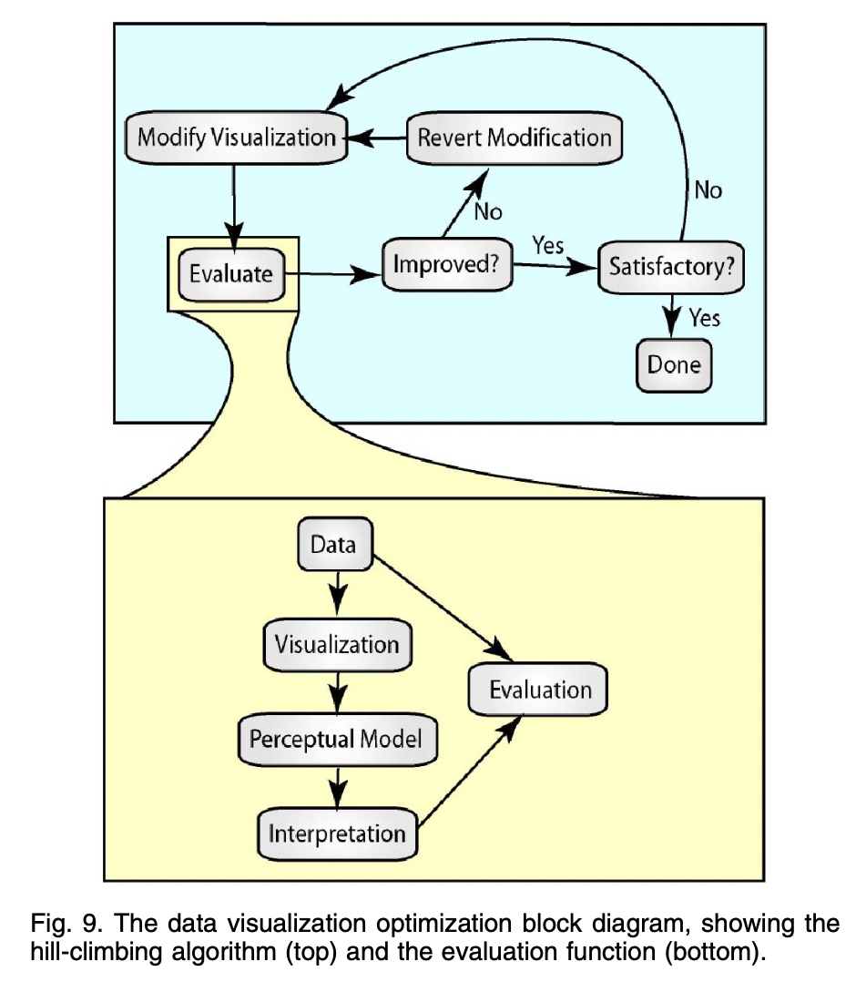
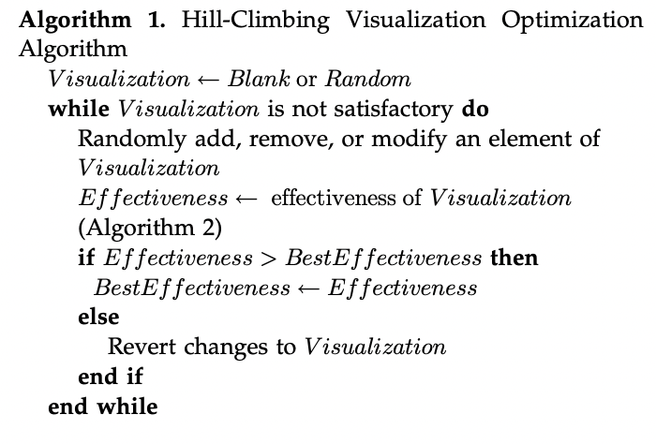
Hill climbing algorithm:
Hill Climbing algorithm is a local search algorithm which is continuously moves in the direction of increasing elevation/value to find the peak of the mountain or best solution to the problem. It terminates when it reaches a peak value where no neighbor has a higher value.

Slide 12
Implications and Discussion
Enhancing Data Visualization
The evaluation and optimization process has provided valuable insights for enhancing data visualization.
By leveraging computational modeling of perception, we can design visualizations that better align with human cognition and improve information comprehension.
Improving User Experience
Optimized visualizations can significantly improve the user experience.
Users can more easily interpret and extract meaningful insights from the data, leading to better decision-making and problem-solving.

Slide 13
Future Research Directions
The evaluation and optimization process opens up several avenues for future research.
Further exploration of computational modeling techniques can uncover additional insights into perception and cognition, leading to even more effective data visualizations.
Real-World Applications
The findings from this process have direct implications for real-world applications.
Industries such as business intelligence, hea lthcare, and finance can benefit from optimized data visualizations that improve decision-making and communication.

Slide 14
Evaluation and Optimization of 2D Flow Visualizations
The evaluation and optimization of 2D flow visualizations involve using computational modeling of perception to improve the effectiveness and efficiency of visual representations of flow data.

Slide 15
What is Computational Modeling of Vision?
Computational modeling of vision is a field that combines computer science and psychology to create mathematical models that simulate human visual perception. These models can be used to understand how humans perceive visual information and to optimize data visualization techniques.
Application to Data Visualization Optimization
Computational modeling of vision can be applied to optimize data visualization techniques by taking into account human perceptual abilities and limitations. By using these models, we can design visualizations that are more effective in conveying information and facilitating understanding.

